Slide 1


Gaussian Naive Bayes
Group: one
2024.5.14

Slide 2
C
ONTENTS
1
Introduction
2
Calculation examples

Slide 3
01
Intruduction

Slide 4

Gaussian Naive Bayes
In the vast field of machine learning, classification algorithms play a pivotal role in making sense of data. One such algorithm, Gaussian Naive Bayes, stands out for its simplicity, efficiency, and effectiveness.Gaussian Naive Bayes is a type of Naive Bayes method where continuous attributes are considered and the data features follow a Gaussian distribution throughout the dataset. In Sklearn library terminology, Gaussian Naive Bayes is a type of classification algorithm working on continuous normally distributed features that is based on the Naive Bayes algorithm.

Slide 5
Naive Bayes Classifier:
The Naive Bayes Classifier is based on a simple concept from probability theory called the Bayes Theorem. The ‘naive’ in the name of this algorithm is used based on the assumption that this algorithm considers while predicting the label of the features. The assumption here is that all the features are independent of each other, though this might not be true in a real-world scenario.
Prior Probability (P(y)):
Class Conditional Probability(P( X_{i}|y)):
This is the probability of a specific class to happen, this algorithm calculates the prior probability by dividing the occurrence of the class ‘y’ by the total number of instances.
This states the presence of each feature X_{i} given that the class occurring is the class y. This probability is considered for each class and each feature.

Slide 6
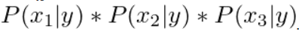
Naive Bayes Classifier:
P(y|x)
P(x|y)
P(x)
This is the probability that will help the algorithm determine each class probability of occurrence. Here P(y|x) tells us about the occurrence of class y given the feature x.
This is the product of all the conditional probabilities of each feature Xi given a class y.
This is the probability of occurrence of feature x, it reduces a probabi-lity function to a distrib-uted function where the total probability is 1.

Slide 7
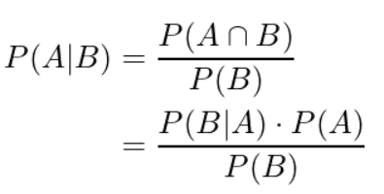
Bayes Theorem
Bayes theorem is a way to develops a way to update probabilities based on new information. The theorem is given as:
Where P(A|B) is the posterior probability and states probability of occurrence of A given B has happened, P(A) is the prior probability, P(B) is the probability of occurrence of event B, P(B|A) is the probability of occurrence of B given A has already happened.

Slide 8
02
Calculation examples

Slide 9

Gaussian Naive Bayes
Gaussian Naive Bayes is the application of Naive Bayes on a normally distributed data. Gaussian Naive Bayes assumes that the likelihood(P()) follows the Gaussian Distribution for each within .
To classify each new data point x the algorithm finds out the maximum value of the posterior probability of each class and assigns the data point to that class.

Slide 10
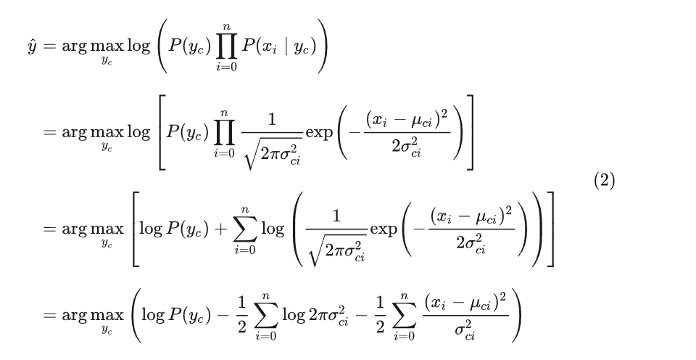
Gaussian Naive Bayes
After the conditional probability of each feature dimension is calculated, the posterior probability is calculated by maximizing it

Slide 11

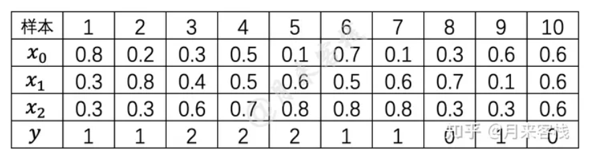
Calculation examples
Suppose there is now a TF-IDF-based method to represent text data, which contains a total of These three characteristic dimensions x₀,x₁,x₂,Each dimension represents the TF-IDF weight of the corresponding word in the vocabulary, Y indicates the category to which the sample belongs.Now you need to predict x=[ 0.5, 0.12, 0.218] to which this sample belongs.

Slide 12
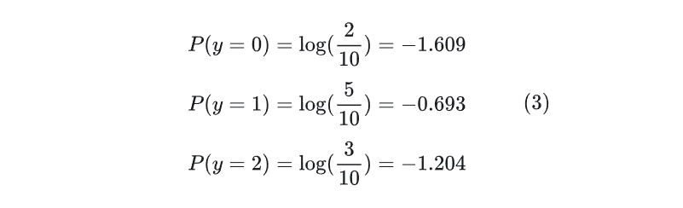
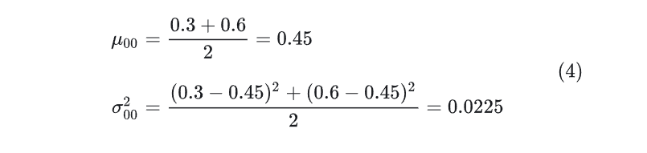
Calculation examples
As can be seen from the table, the prior probabilities of each category are
When y=0, the parameter expectation and variance corresponding to feature x0 are

Slide 13
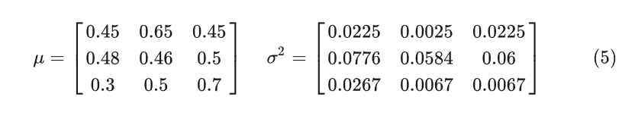


Calculation examples
denotes the expectation corresponding to the i-th feature of the c-category and a denotes the variance corresponding to the i-th feature of the c-category.

Slide 14
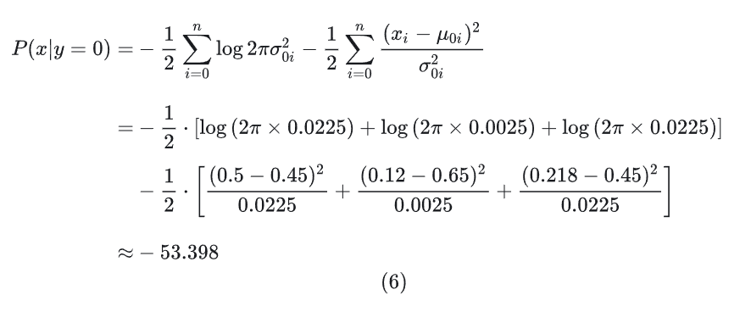

Calculation examples
Further, according to Eq. (2),When x = [ 0.5, 0.12, 0.218] and y = 0, the corresponding conditional probability is
and

Slide 15
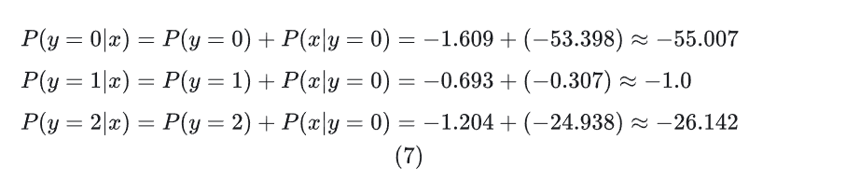
Calculation examples
Further, each posterior probability is
According to the results of Eq. (7), the "probability" that sample x=[ 0.5, 0.12, 0.218] belongs to the category y=1 is the largest. At the same time, the result in Eq. (7) is usually softmaxed when the probability is output, and the probability values of the final sample x belonging to the three categories are 0, 1.0, and 0,

Slide 16
Thanks

